Slide 1
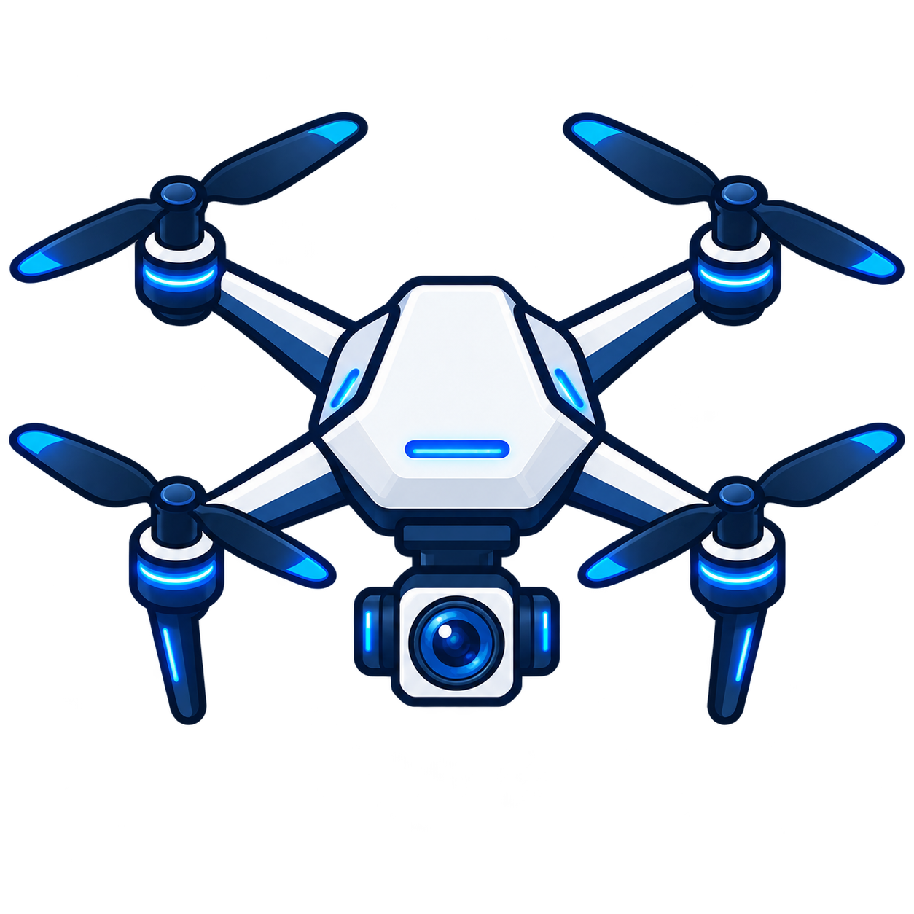


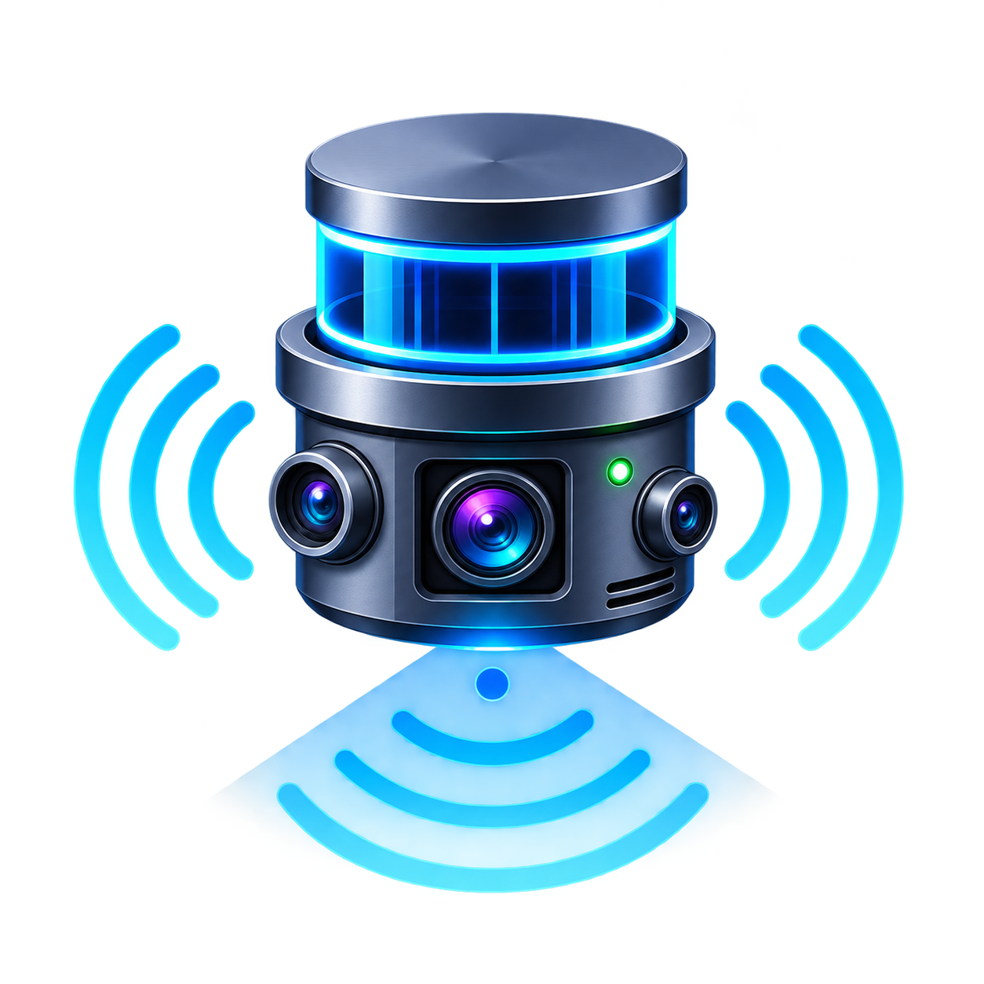





Ground control station
Flight controller
AI layer
Sensor inputs
Camera’s frames
Agents
Agent 1
Current flight state policy
Tracking corrections
User interface
(React.js web app)
Landing corrections
Agent 2

